Slide 1
Business Economics
Marcelo Ortiz M.
Fall 2025

Slide 2
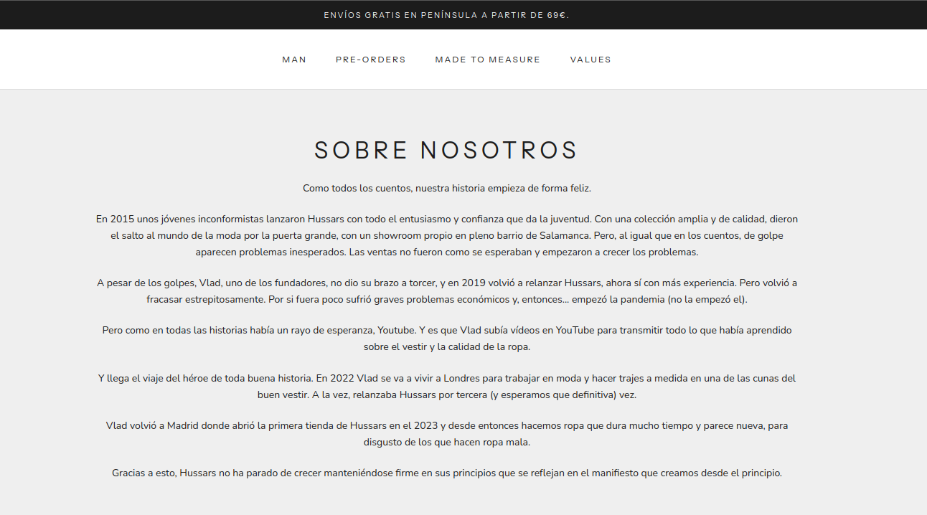

Mock Exam “Hussars”

Slide 3
Mock Exam “Hussars”
Core Business
Focus: Design and retail of high-quality menswear (and a smaller selection for women).
Style: The brand focuses on "Old Money", classic, and timeless aesthetics (e.g., preppy, sartorial basics).
Value Proposition: They emphasize European manufacturing (Spain, Portugal, Italy), durability, and high-quality fabrics (Pima cotton, Merino wool) as a reaction against "fast fashion."
Size:
Historically, one store in Madrid but in the last year they started three new ones in Spain (Barcelona, Valencia, Santander)
13 employees
LINK COMPANY
LINK YOUTUVE VIDEO

Slide 4
Mock Exam: Part 1 “Hussars”
Decision Right Allocation:
1) Specialization: legal knowledge and technical knowledge. How should Hussars organize its Procurement Division? 2 benefits and costs
2) Centralization: 2 benefits and costs of a decentralized Procurement Division across business lines: shoes, jackets, socks.
3) Specialization: 2 benefits and costs of specialized design for men and women.
Compensation and Incentives:
1) how to incentive store managers across cities?
Vertical Integration:
1) describe the hold-up problem faced by Hussars: specific asset?
2) provide 2 benefits and costs of long-term contracts relative to the spot market.

Slide 5
Mock Exam: Part 2
Education in Estonia
Video
1) decision rights about the teaching program: where are they allocated? Pros and cons relative to centralized decision-making.
2) teachers’ compensations: what risks are under teachers’ control? Do they have enough decision rights to handle them?
3) teachers’ evaluation: Discuss the observability is teaching outcomes. How can teachers manipulate their evaluations?

Slide 6

This course in 2 slides:
1) Economic choice model and Contracting costs
Contracting
- Market Transactions
- Agency Relations (organizations)
1) Preferences
2) Restrictions
3) Property rights
4) Bounded Rationality
5) Opportunity Cost
1) Preferences
2) Restrictions
3) Property rights
4) Bounded Rationality
5) Opportunity Cost
Price Control
Reduction of contracting costs:
- information (binding product information, critical components, standardized labels)
- enforcement (e.g., efficient laws and courts)
- and so on.

Slide 7


This course in 2 slides:
2) Organizational efficiency within the Economy
3 pillars
3 pillars
1) Decisions are made by people.
2) Preferences and choices within organization/contracts.
3) Relative efficiency vs markets and other organizations: 3 pillars

